Slide 1
Version Control with GitKraken and GitHub (Advanced) Part 2: Using Git Flow to Collaborate

Slide 2
Benjamin Daniels, DIME Analytics (WBG): I work supporting research reproducibility and best practices for the DIME portfolio.

Slide 3
RT2 Roadmap
Pre-Registration
Transparent Reporting & Disclosure
Pre-Analysis Plans
Data Repositories
Researcher Degrees of Freedom
Scientific Misconduct
Power Planning
Dynamic Documents
Results-Blind Review / Registered Reports
Publication Bias
Failure to Replicate
Preprints
Data Management,
De-Identification
Open Access
Version Control
Dynamic Documents

Slide 4

REVIEW: What is Git/GitHub?
First, Git is not GitHub.
Second, GitHub is not Git.
Git is a version control software. It organizes versions of every file in a project in an orderly way.
GitHub is a “development platform”. It manages contributions to projects in an orderly way.
Together, Git and GitHub allow you to avoid the “FINAL”.doc problem.

Slide 5
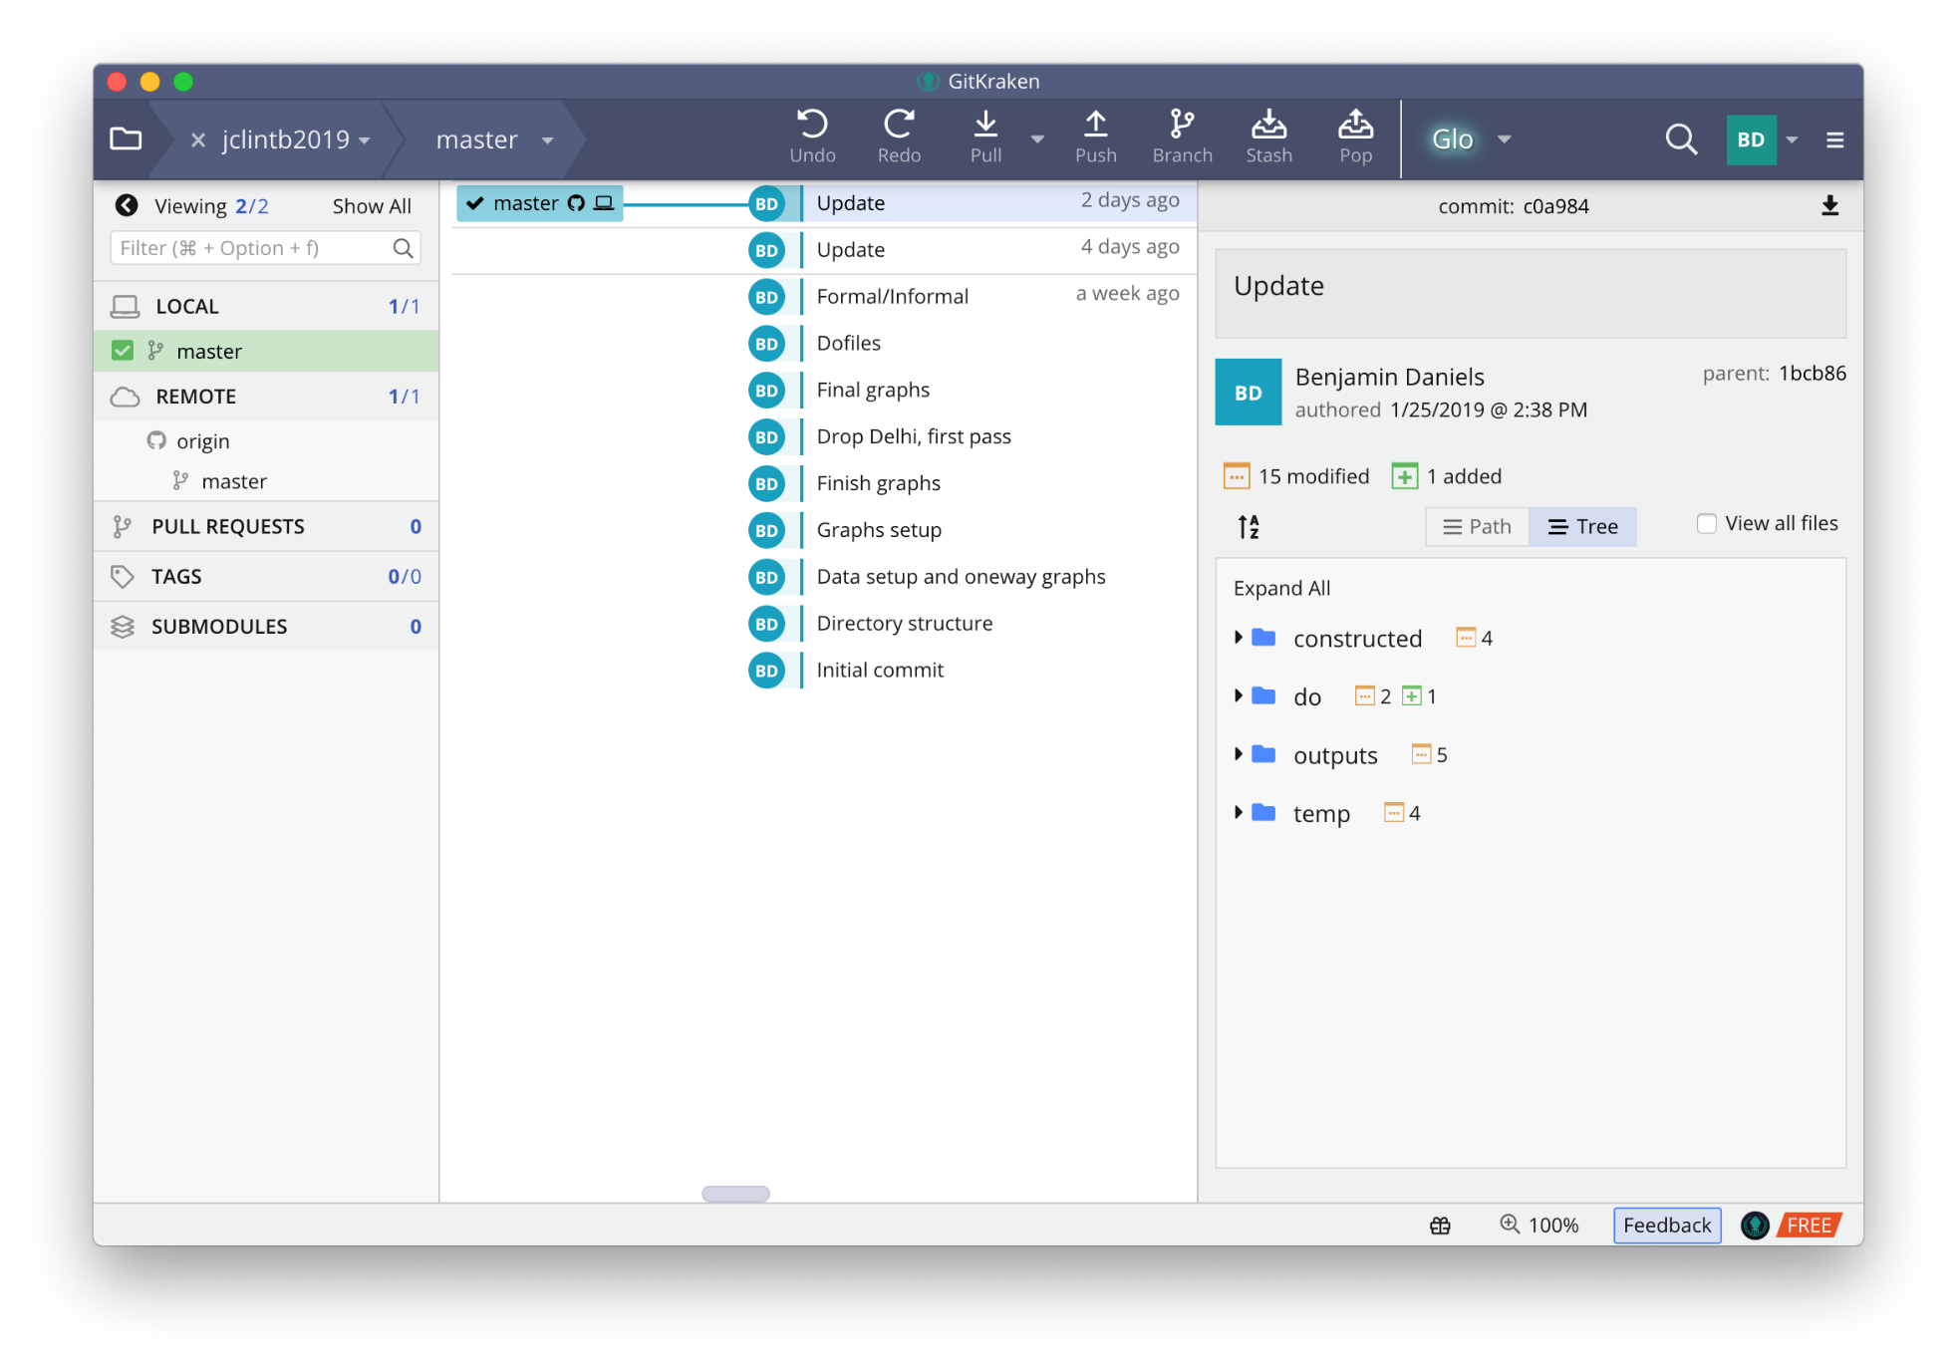
Git: The basics
Git is a software that runs on your computer. It stores “version histories” of your files in a way that is really useful, but that you mainly don’t need to understand.
The complete history of a project is called a “repository”. A repository can be viewed in a desktop “client”, such as GitKraken, shown here.
A very simple repository would look much like this one: it has a series of versions called commits that make up its history. Each commit is a record of the changes between itself and the previous commit.

Slide 6
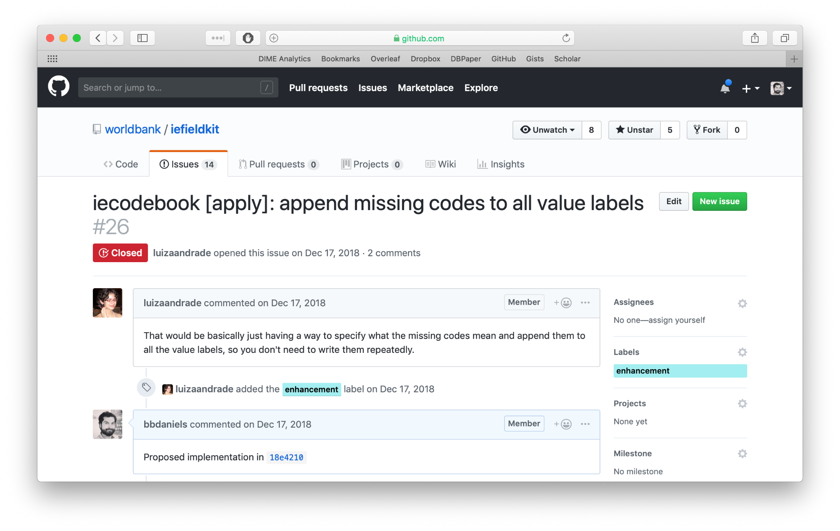
GitHub: The basics
GitHub is a website that you can use to manage collaboration with other people.
This has two main forms: first, managing and tracking tasks (known generally as “issues”), and second, allowing people to submit new materials to the repository.
A very simple issue looks like this one: A problem is posed, and after some discussion a solution is submitted as a “pull request” to the repository.

Slide 7
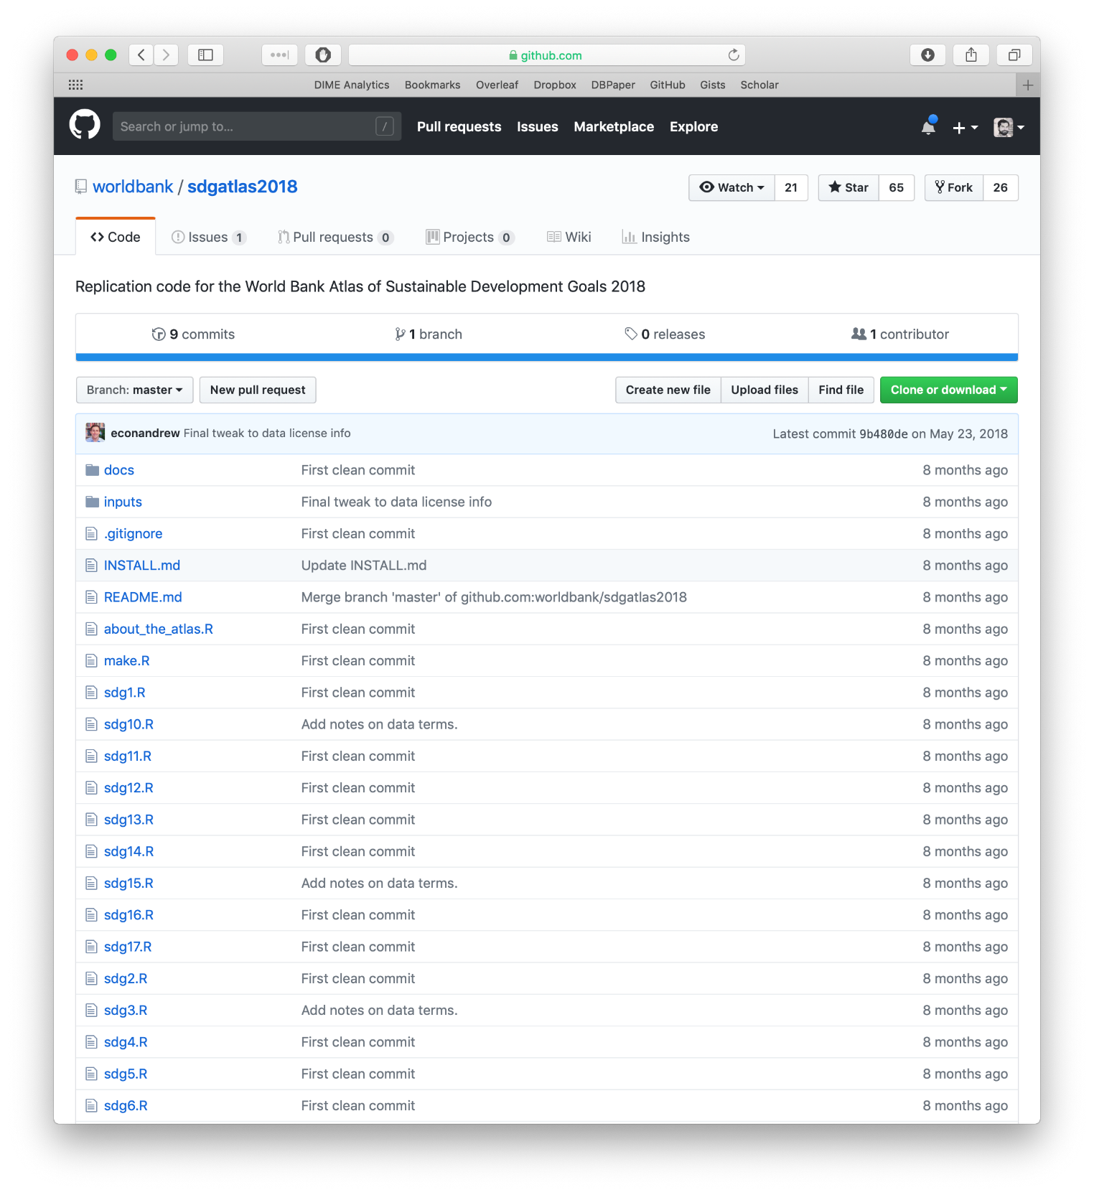
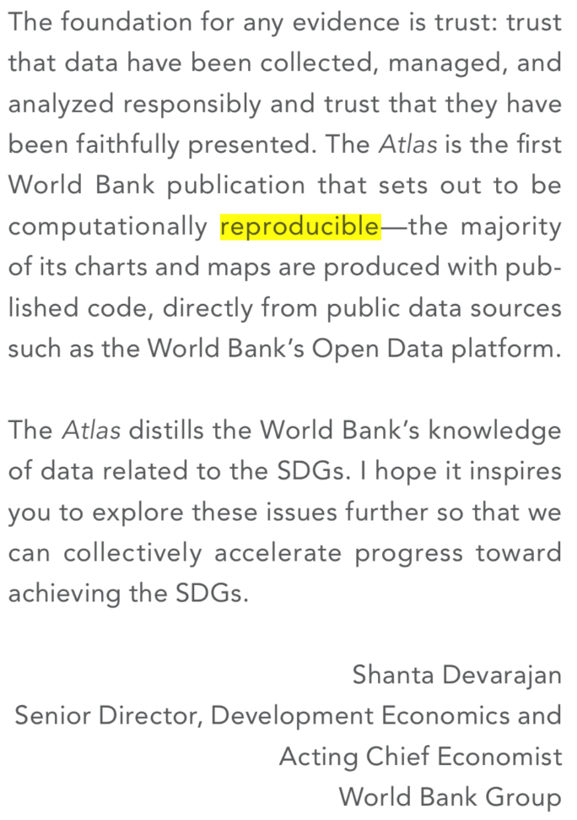
Git & GitHub: The basics
Mastering Git with GitHub gives you an awesome tool for managing your own team’s workflow, as well as for making and releasing big projects.
Having both your data, code, and code history available for all authors and the public makes an incredibly useful tool as a product of your work.
Plus, Git protects all your files much better than other software.
(Shown here: The World Bank Atlas of Sustainable Development Goals.)

Slide 8
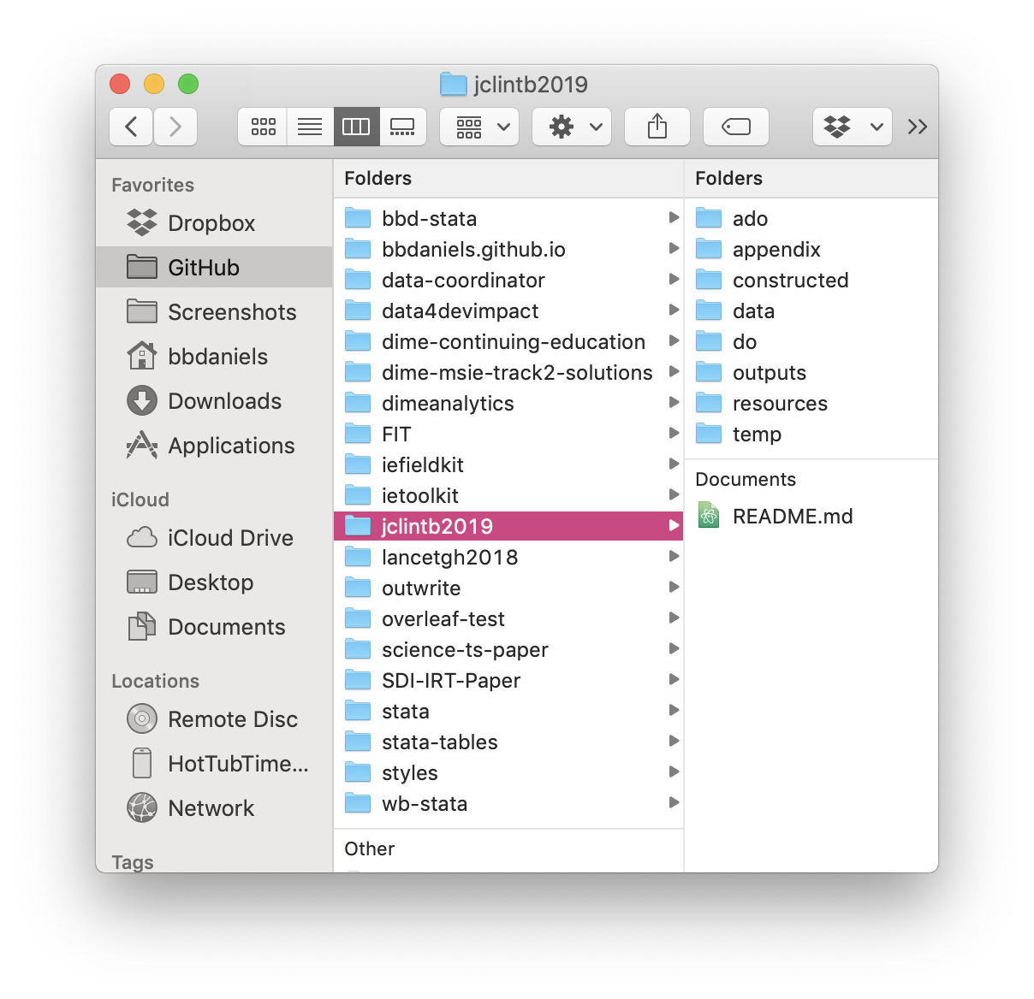
The files are not the repository
Your Git repositories will probably mainly be used to manage a lot of files. But it is important to remember that although the terms are often used semi-interchangeably, the “repository” is not the files themselves.
The files live in what we will call the “working directory” – the project folder (“directory”) where you are working.
A Git repository manages the contents of the working directory.

Slide 9
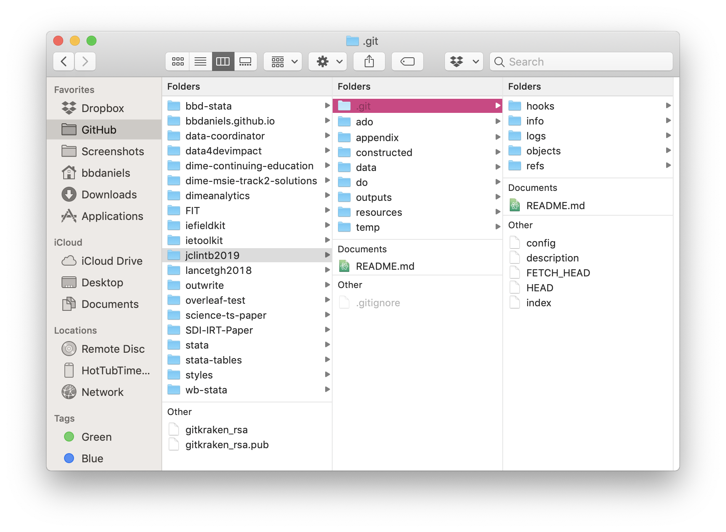
What is the repository then?
You really don’t need to remember this, but:
The Git repository is a bunch of hidden files inside the working directory. This is where the magic happens.
It’s hidden because you never need to touch these. NEVER.
Just pretend this doesn’t exist – everything important happens entirely inside your Git client.

Slide 10
So how does it work? Part 1: Review commits and branches

Slide 11
Git creates commits
The most important thing Git does is create “commits”.
A commit is a snapshot of the entire working directory. Each commit has a name and a timestamp.
You have to tell Git when to create new commits. This is probably the biggest difference from whatever you do now.

Slide 12
Commits name past versions
Git watches your saved changes
But it only stores them when you tell it to: this is a “commit”
You can name these so that they make sense and are easy to find when you need them in the future (you always need them when you least expect, right?)
Required Reading: Git vs Dropbox https://michaelstepner.com/blog/git-vs-dropbox

Slide 13
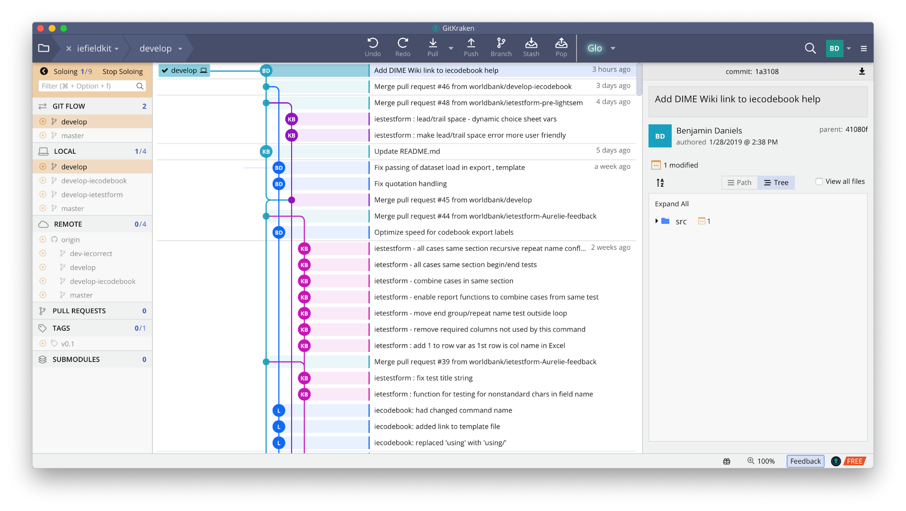
Git creates branches
Branches are the “killer feature” of Git. Nearly every advanced Git usage you learn will be about how to manage branches.
Branches enable different people to work on the same thing at the same time, and they enable you to view different versions of your files.
Branching allows you to move forwards or backwards in time; and to move “horizontally” in time through various concurrent versions.

Slide 14
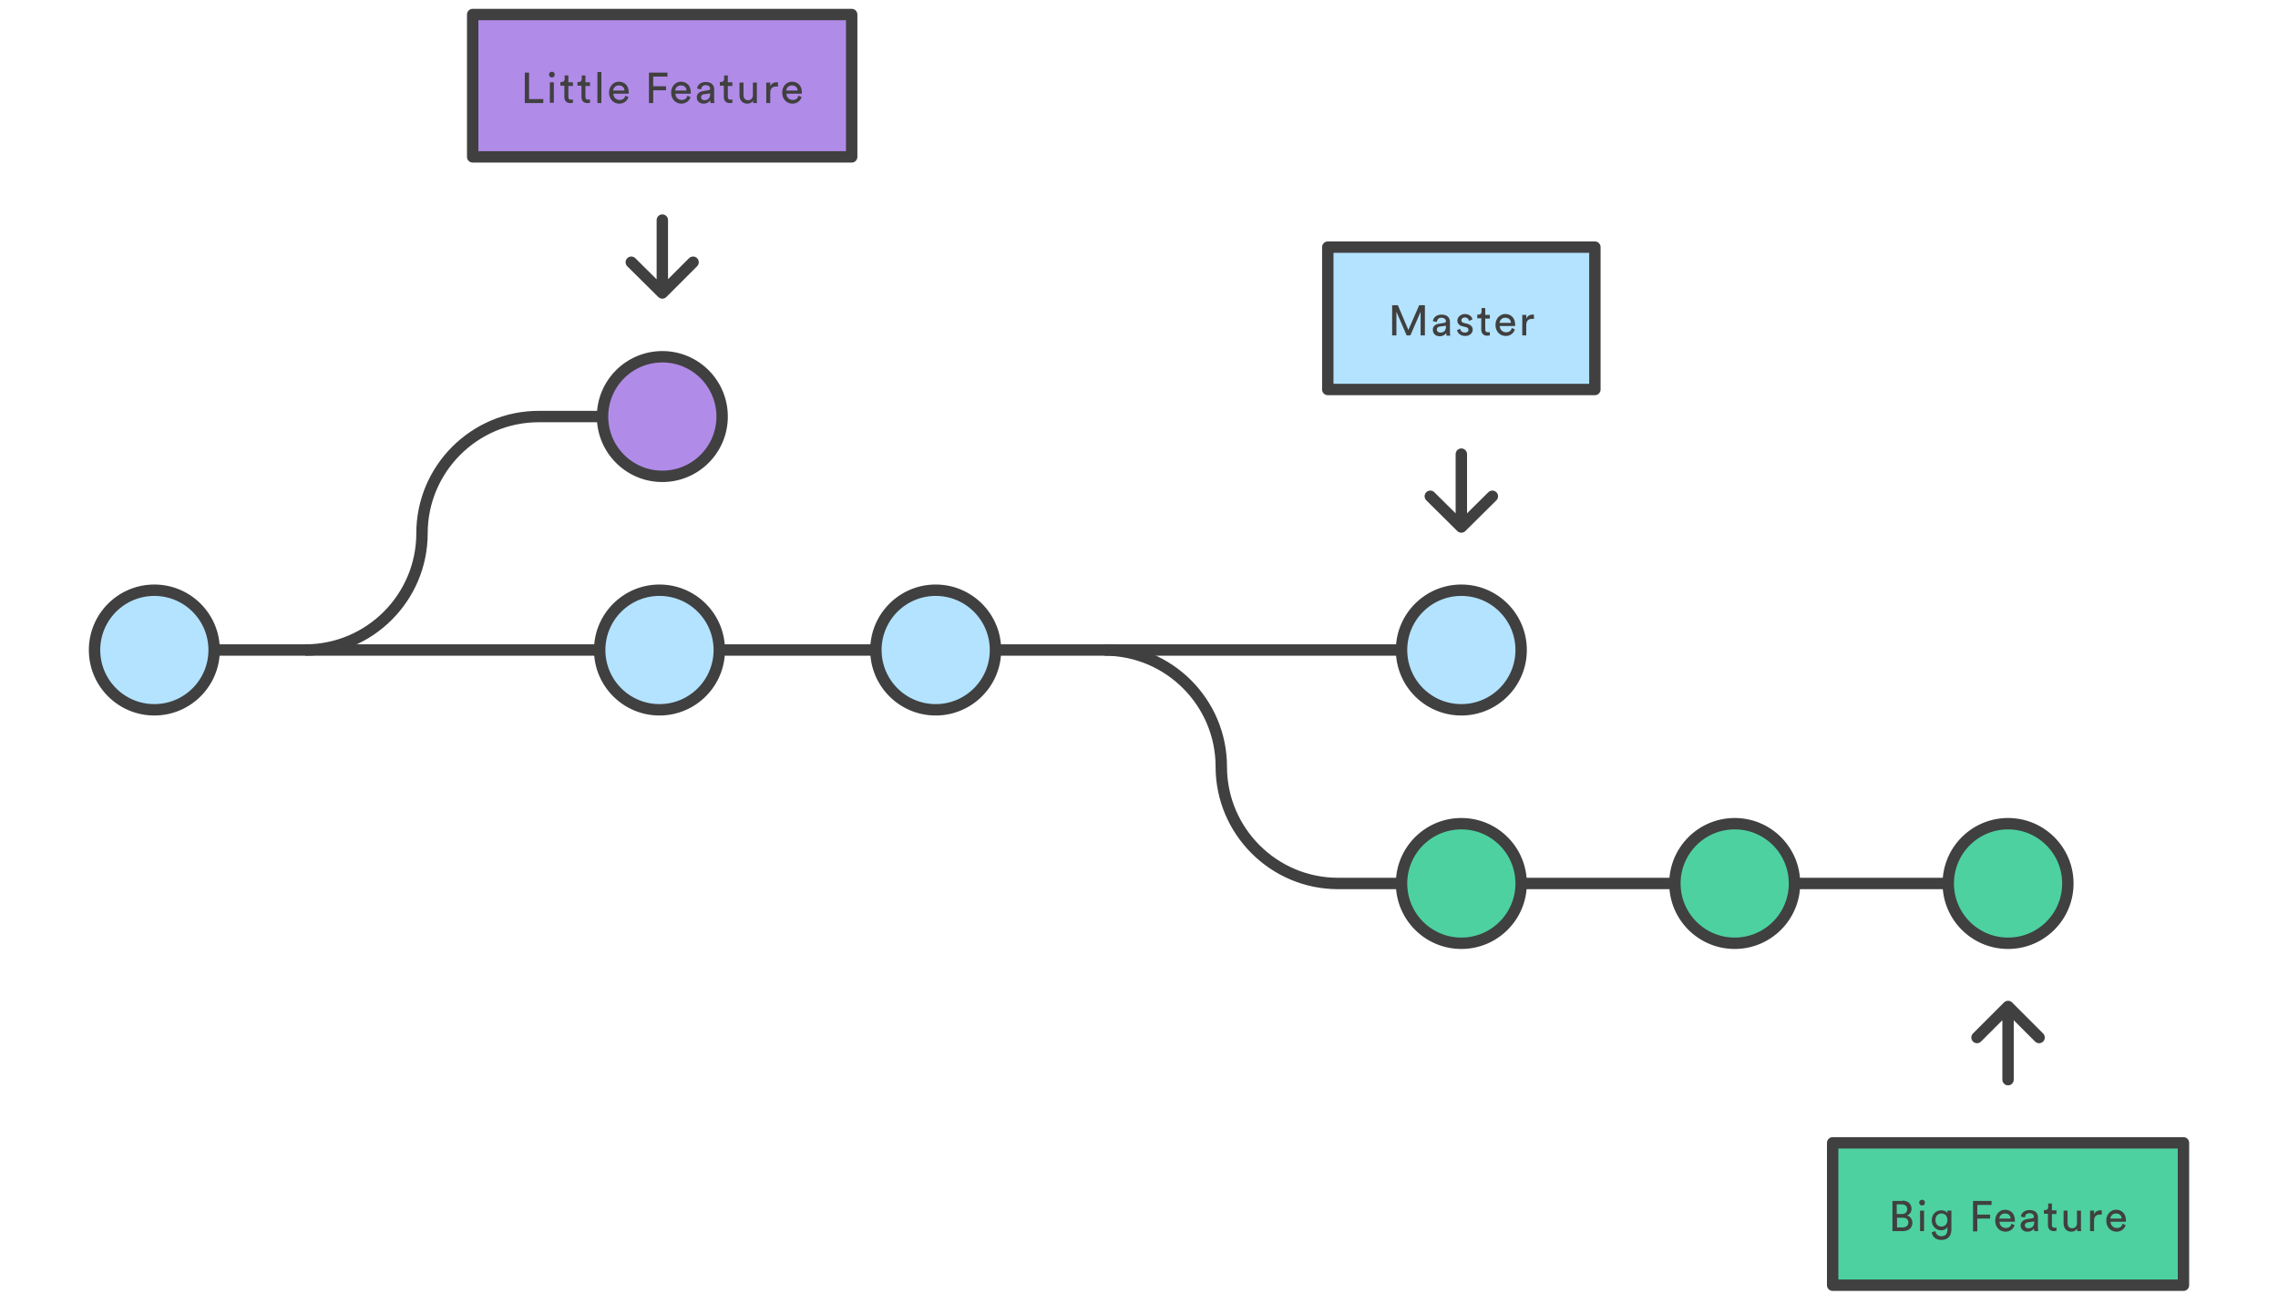
Branches name current versions
Each “branch” points to a commit, usually the latest version in some development workflow. You can switch between branches locally. When you do, your working directory will look exactly as it did when that commit was made.
Every contributor can be on any branch they like at any time – past or current.
This means various experimental changes can be made simultaneously without affecting the current edition of a product.

Slide 15
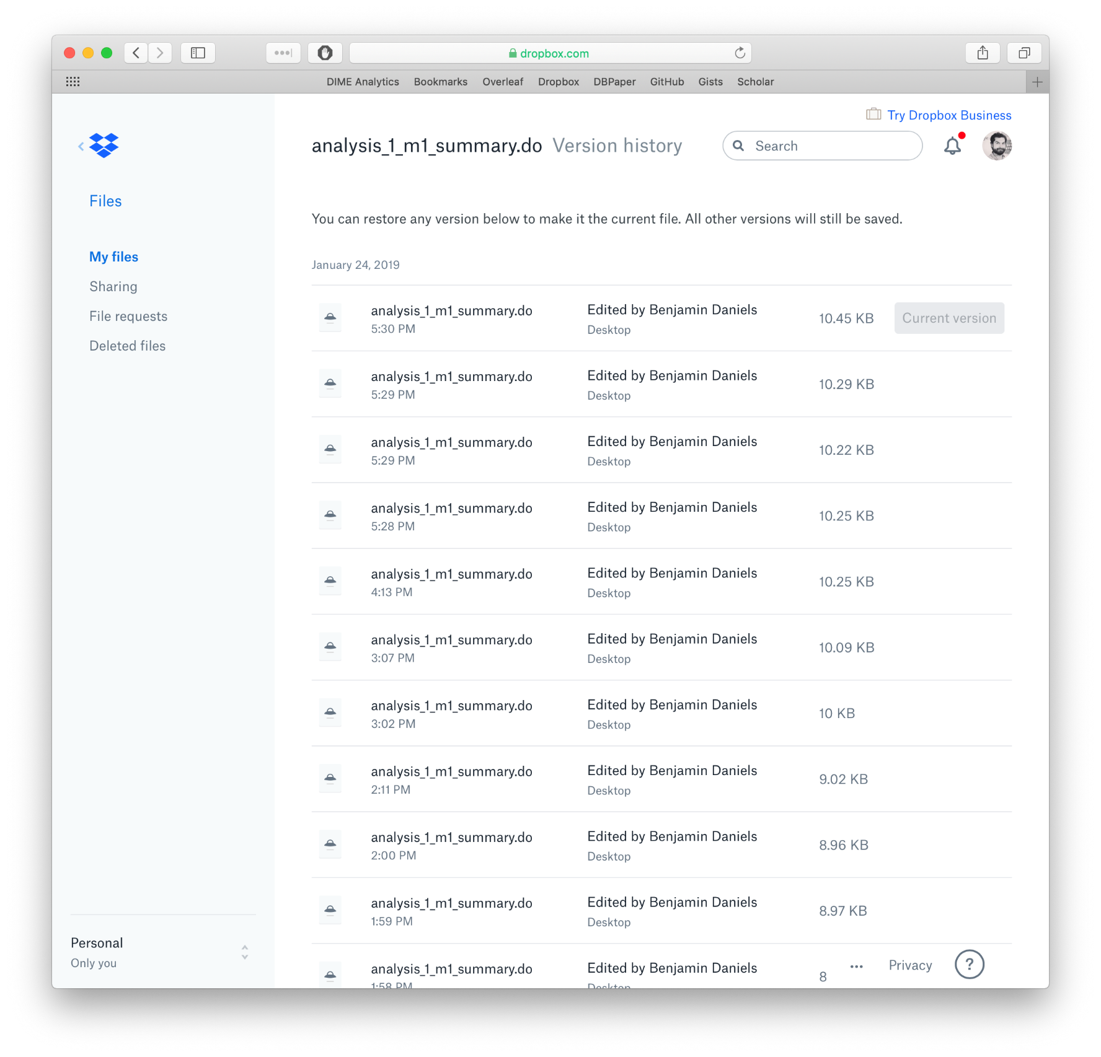
How is that better than Dropbox?
Dropbox stores a new snapshot every time you save each file.
You save your work often (right?)
So Dropbox stores many similar images of your files
But you can’t tell which is which!

Slide 16
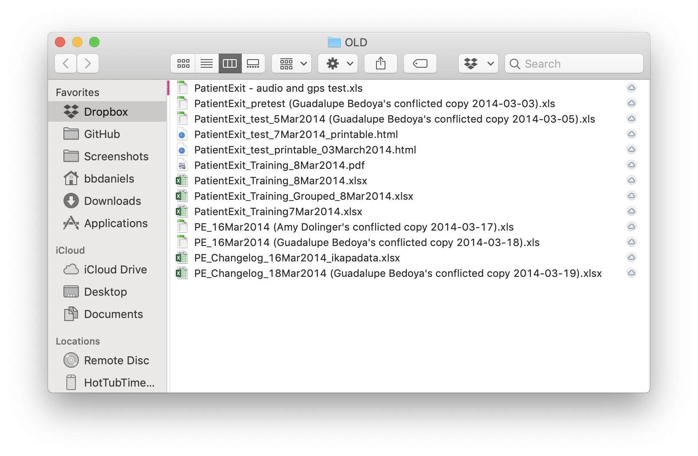
How is that better than Dropbox?
In Dropbox, there can be only one living version of a file at any time – otherwise a “conflicted copy” is created. This means nobody can edit the same file at the same time: Dropbox has no concurrency.
Worse, if you “roll back” a file to a previous version to see what it looked like, this affects everyone’s current version, even if you don’t want it to.
Finally, Dropbox versions are costly (computationally) – so they delete them often without telling you.

Slide 17
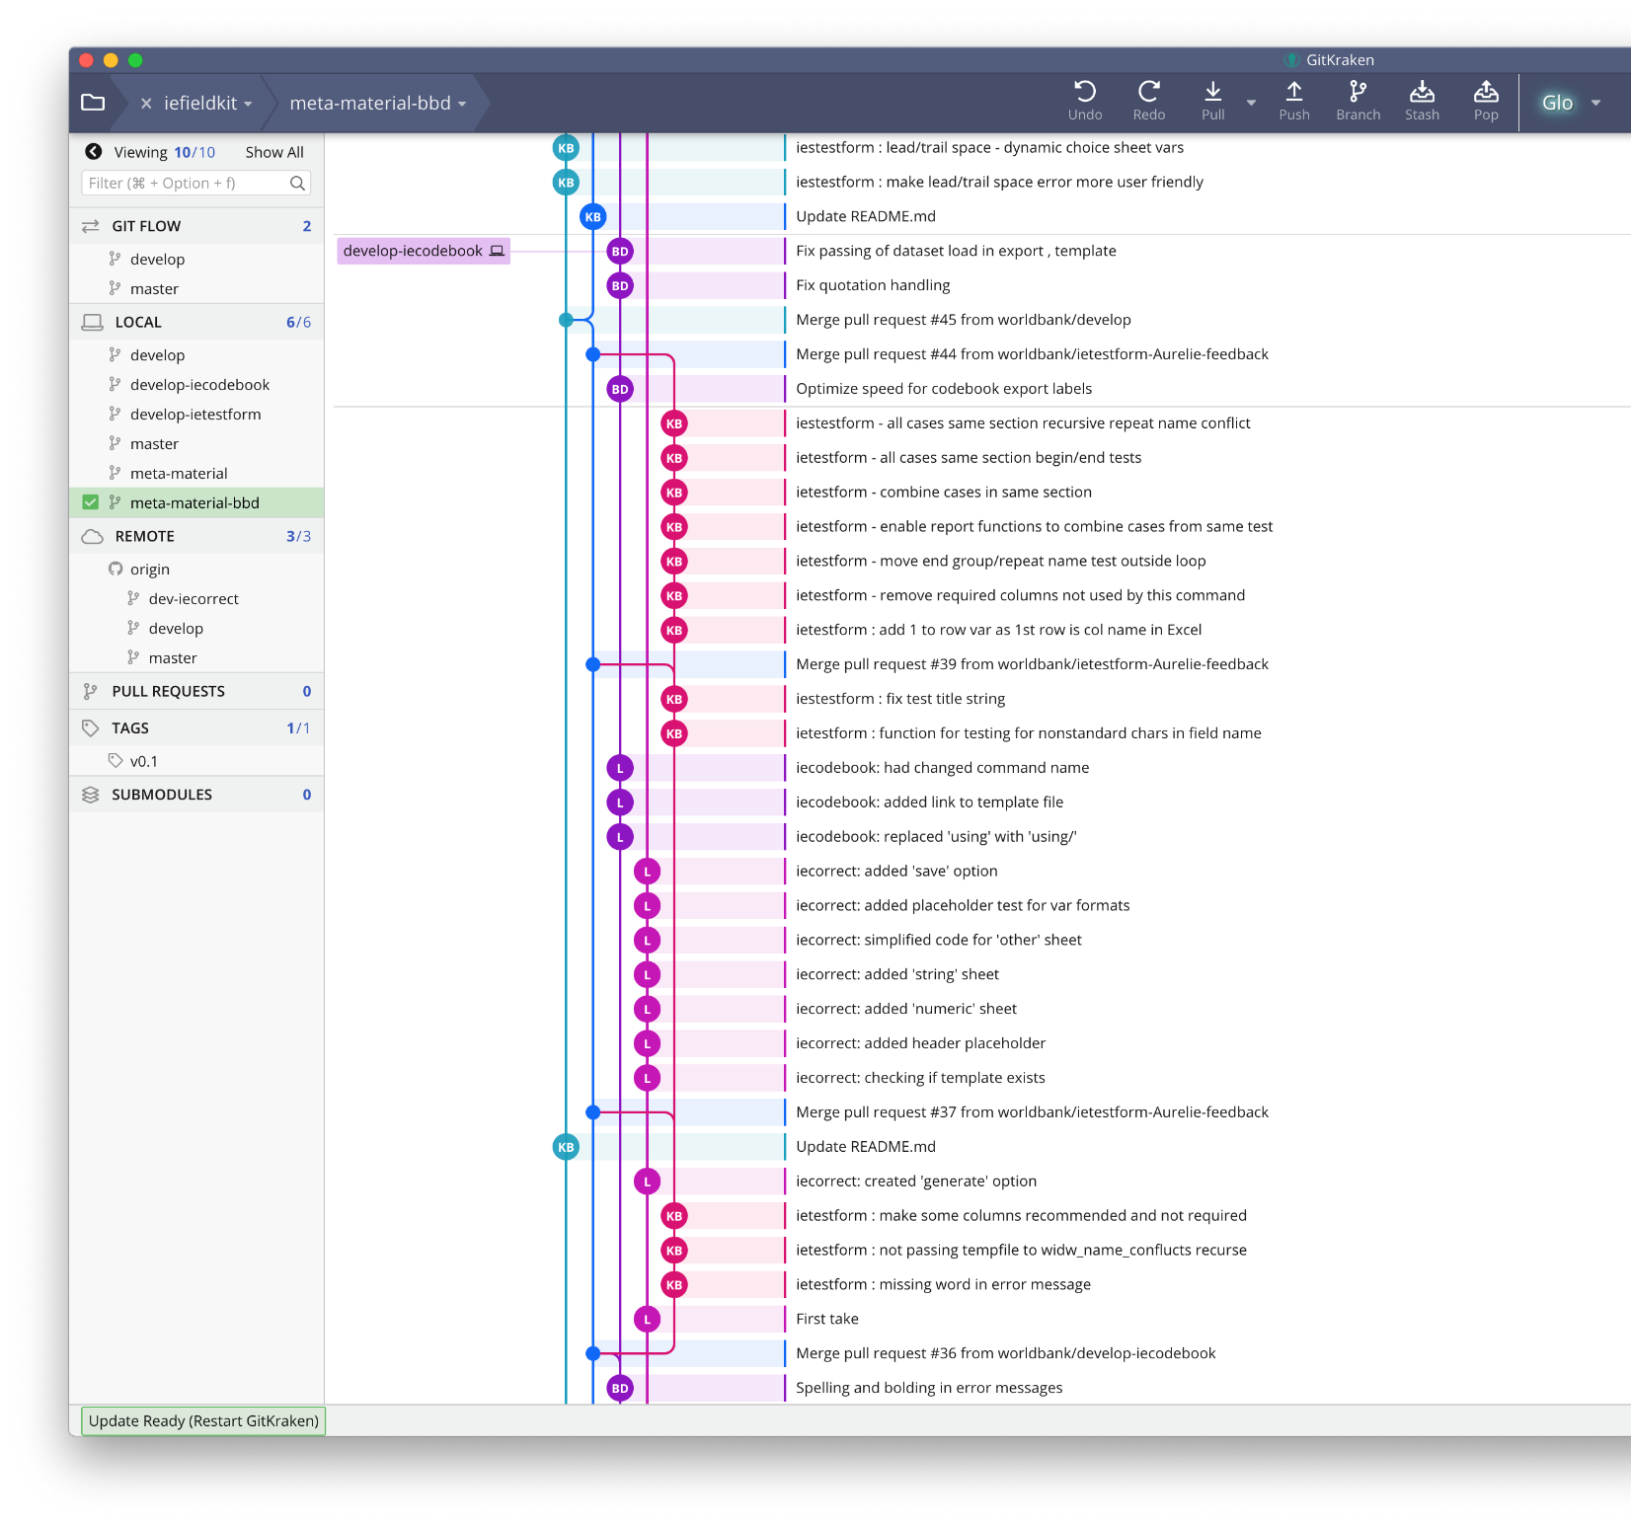
This can get complicated.
To make sure we know what we are doing, we need to organize our commits and branches.
This is non-trivial: it was more than 5 years between the release of Git and the development of a “successful” branching model.
You have to think in ways you are not used to thinking when you start using Git, so these workflows will not feel intuitive at all.
But they are worth learning, since Git will not be as useful otherwise.

Slide 18
So how does it work? Part 2: Organize your commits and branches

Slide 19
Git Flow organizes your commits and branches
Git Flow is a similar idea to a standardized folder structure
When you move to another project using Git Flow, you will know what everything is for and how you should be working
Required Reading: Git Flow https://nvie.com/posts/a-successful-git-branching-model/

Slide 20
Core structure of Git Flow workflow
[master] branch is protected, always ready to run, and has sparse commits from [develop]
[develop] branch is protected, “nearly” ready to run, and has frequent commits from [feature] branches
[feature] branches are frequent, specific, personal, and hold all new work

Slide 21
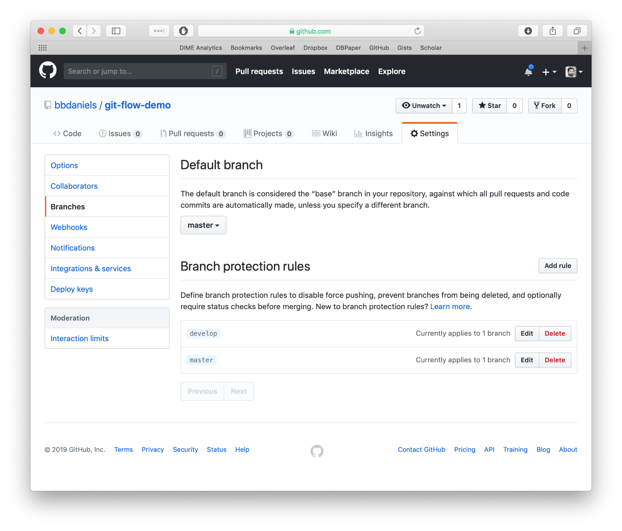
Two “protected” branches
These have rules set on GitHub which prevent:
“Force pushing” (this can be used to overwrite history and is not allowed)
Merging without approval
With these protections in place, the [master] branch is a preserved common status record that nobody edits directly.
[develop] is the common workspace where ready changes are merged after being built in a [feature] branch.

Slide 22
Benefits of Git Flow
Anyone (like the PI) can always open [master] branch and see “where we are”.
Anyone (like the PI) can create a [feature] branch and ask “what happens if I do X?”
You can always look back and see what happened when someone tried something else (abandoned [feature] branches)

Slide 23
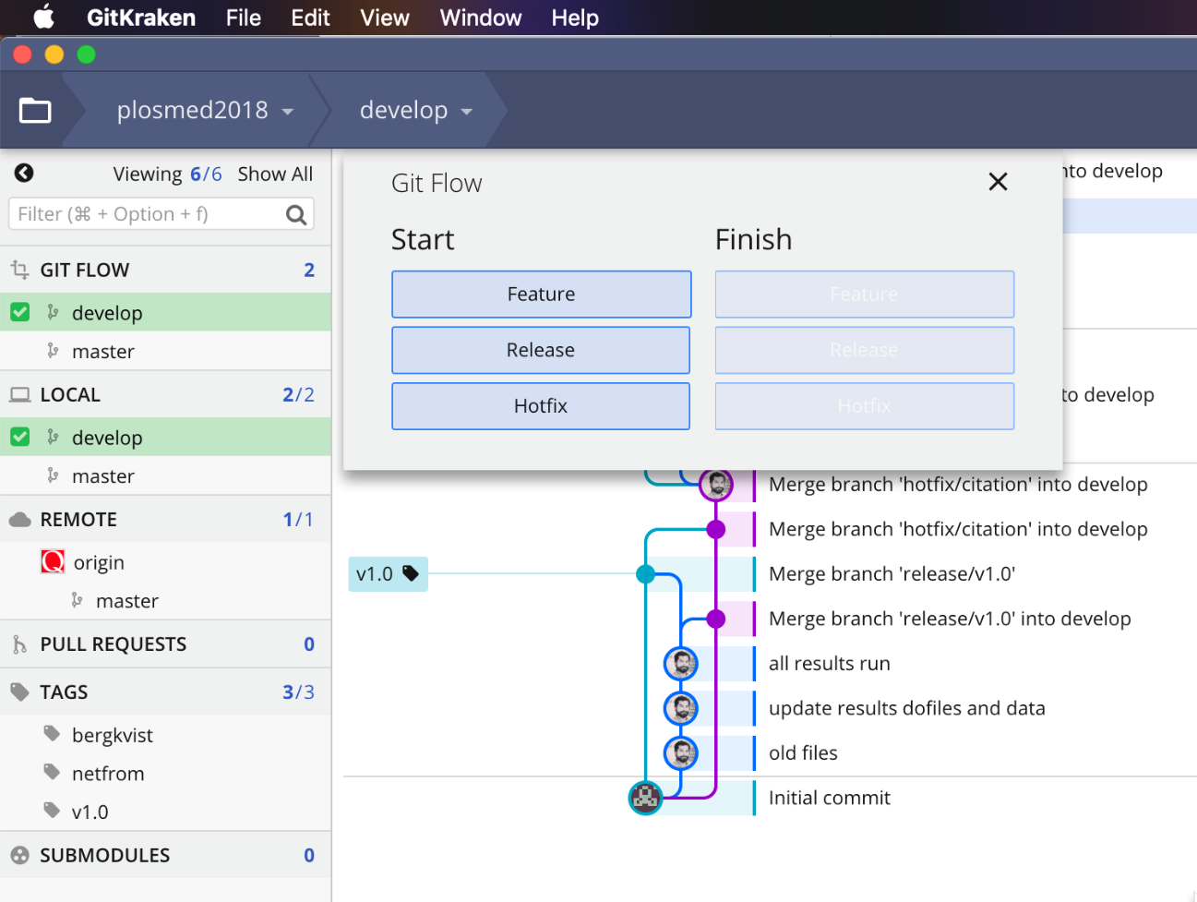
Using Git Flow with GitKraken
Git Flow is so successful it is the default in many organizations, and GitKraken has powerful automatic features for supporting Git Flow.
Send me your GitHub username so I can give you edit access on the git-flow-demo repo

Slide 24
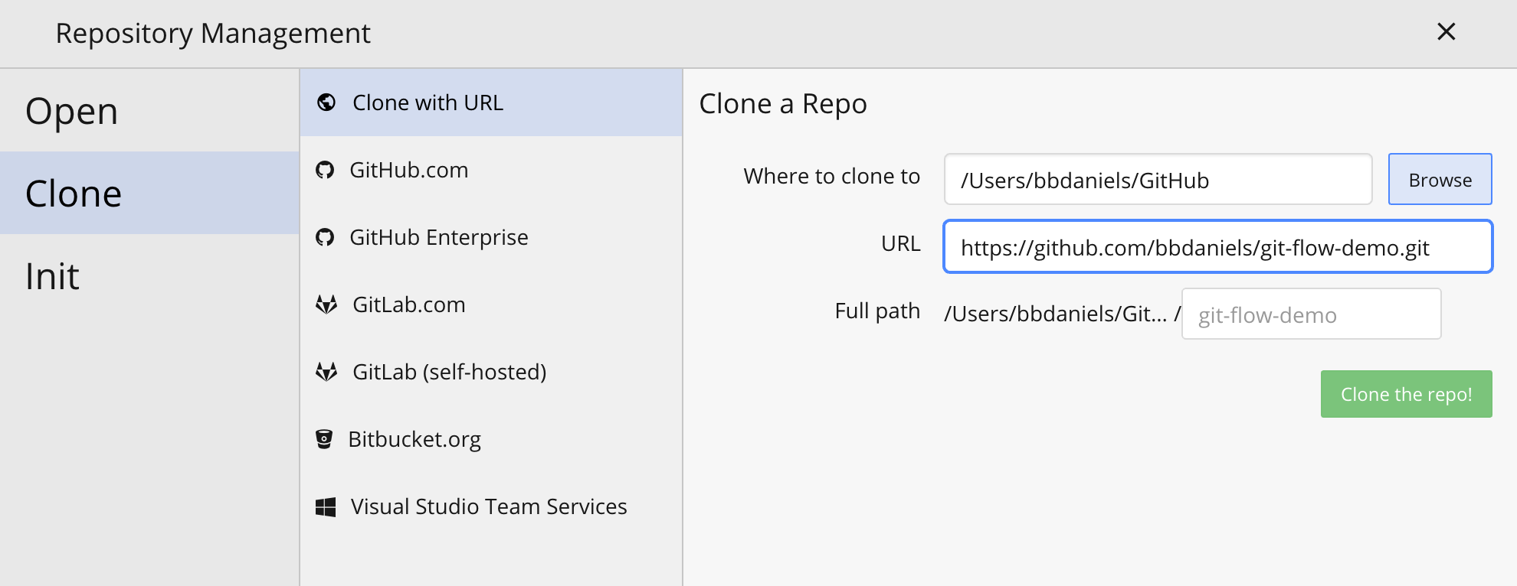
Clone the git-flow-demo repo locally

Slide 25
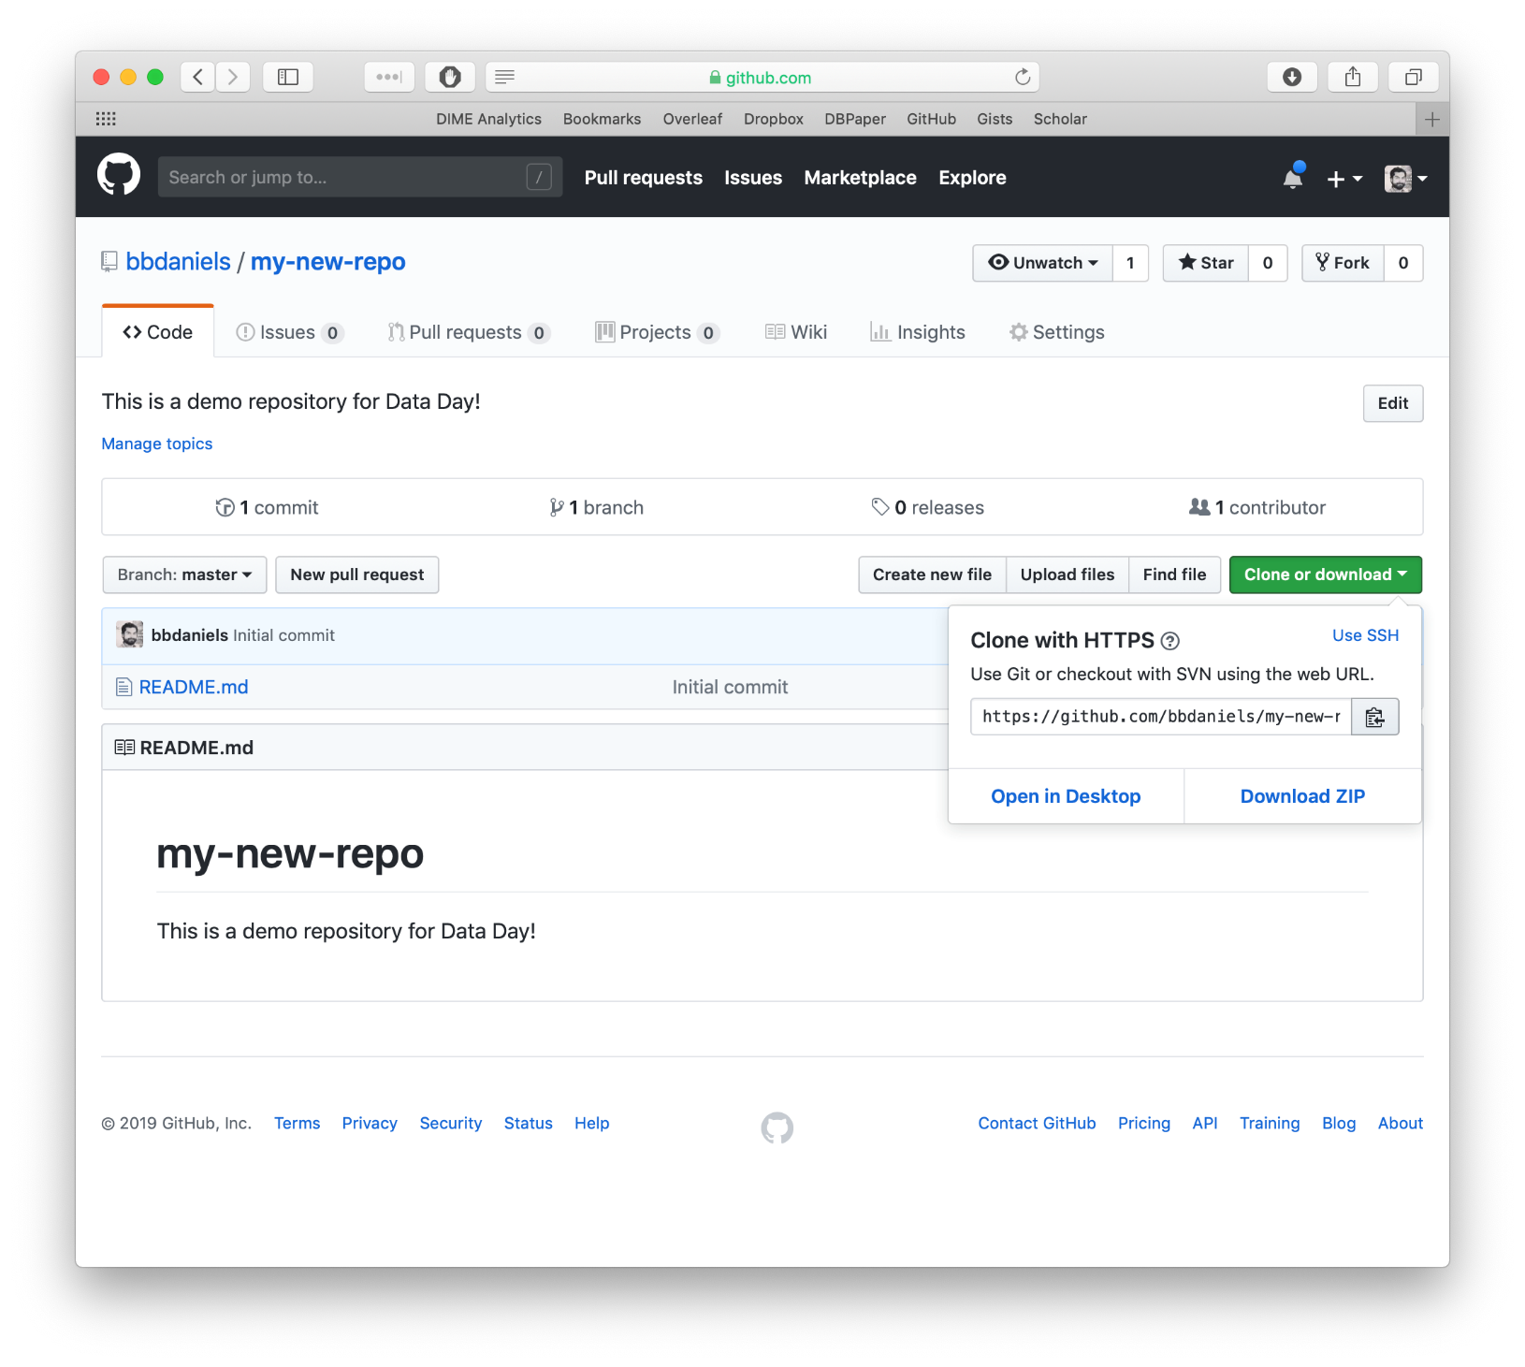
Clone the repo with your desktop client
Cloning the repository makes a complete copy of it at the new location, including the entire history (remember, the repository is the history).
Cloning from GitHub to your local computer is a good way to start a repository.

Slide 26
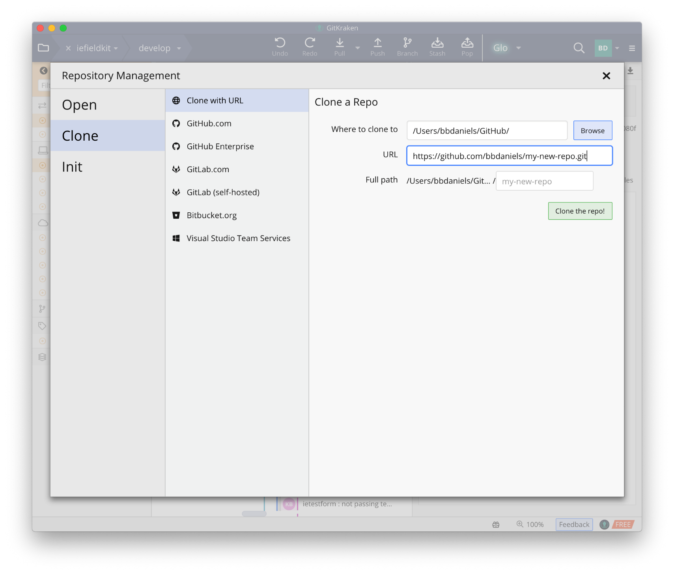
Clone the repo with your desktop client
1
Cloning the repository makes a complete copy of it at the new location, including the entire history (remember, the repository is the history).
Cloning from GitHub to your local computer is a good way to start a repository.
(I know it seems like a lot of steps now, but this becomes second nature. Bear with me, and use this presentation as a guide!)
2
3
4

Slide 27
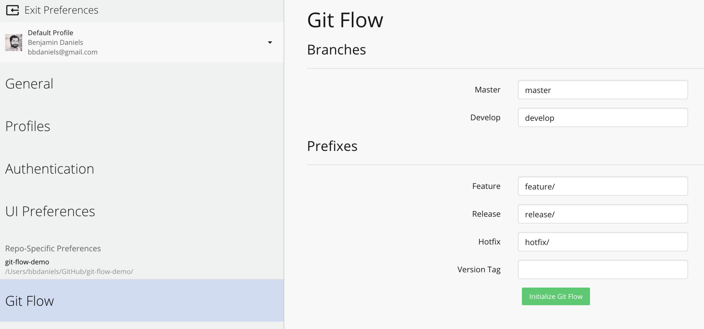
Initialize Git Flow in “Preferences”

Slide 28
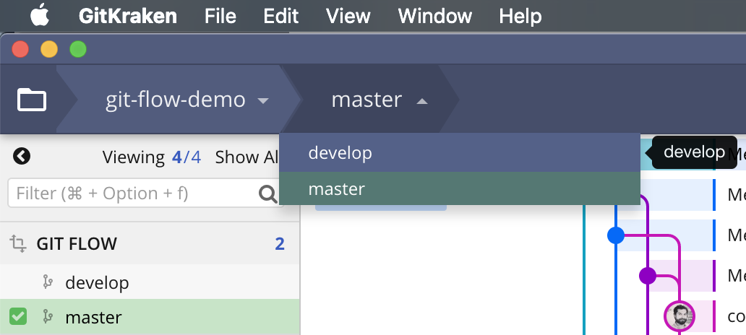
Checkout “develop”
When you “check out” a branch, everything on your computer is instantly updated to what that branch looks like.
Always be conscious to remember “where” you are – this is the core functionality of Git. You’ll get used to it!

Slide 29
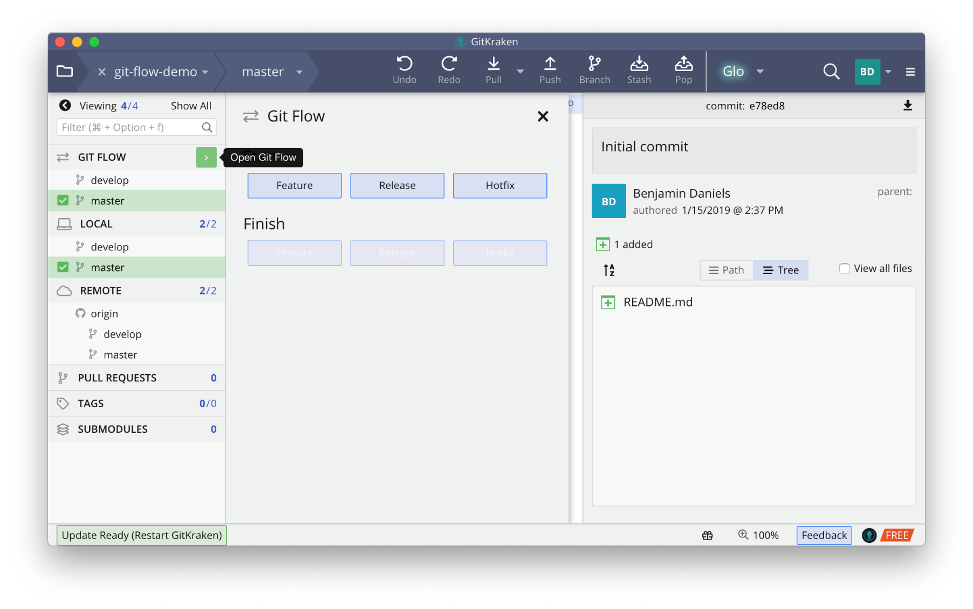
Start a new [feature] branch
On your local machine, use the Git Flow popout to start a new feature. Call it [xx-new-file] where xx is your initials.

Slide 30
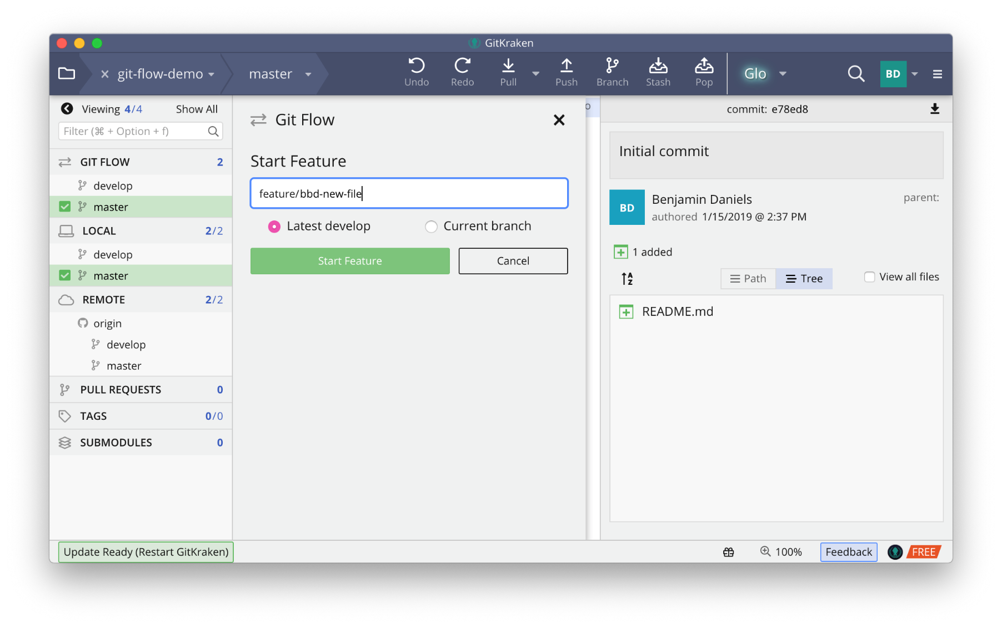
Start a new [feature] branch
On your local machine, use the Git Flow popout to start a new feature. Call it [xx-new-file] where xx is your initials.
[feature] branch names should be single-person and single-purpose: the name is a great place to be clear about those.

Slide 31
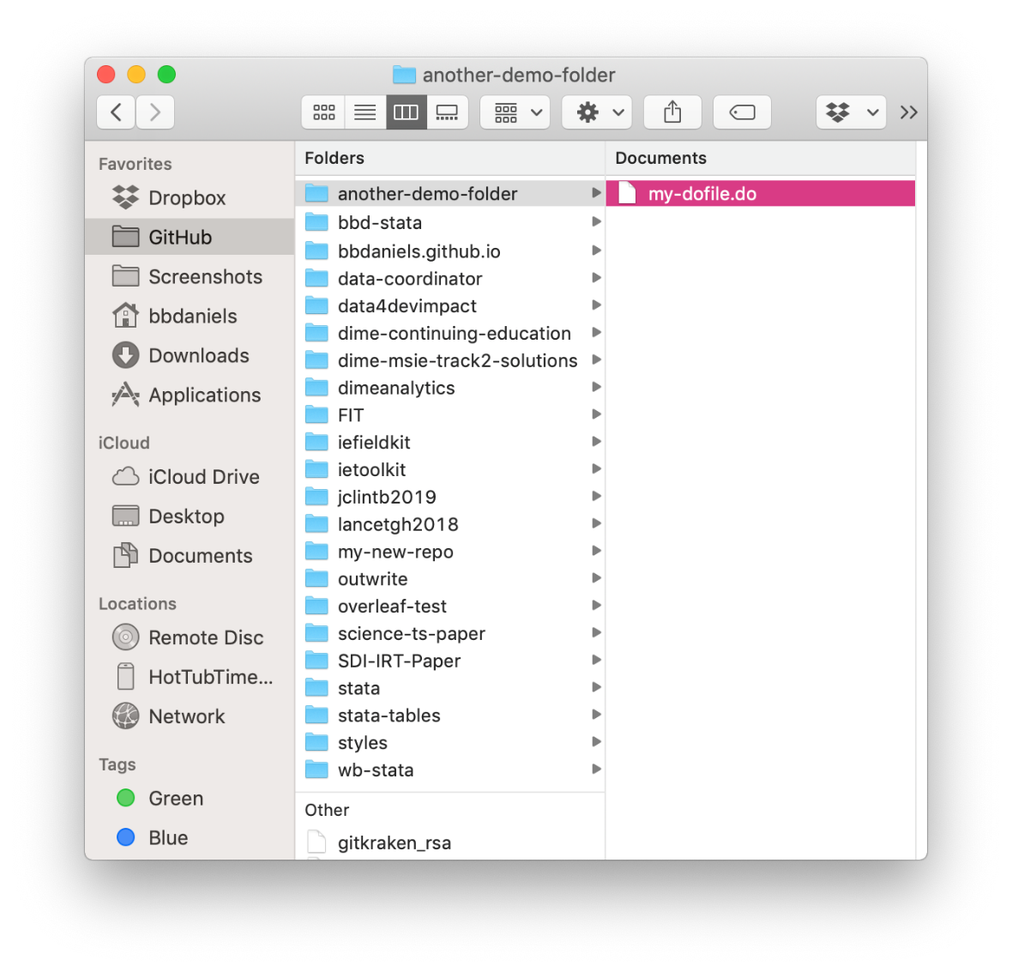
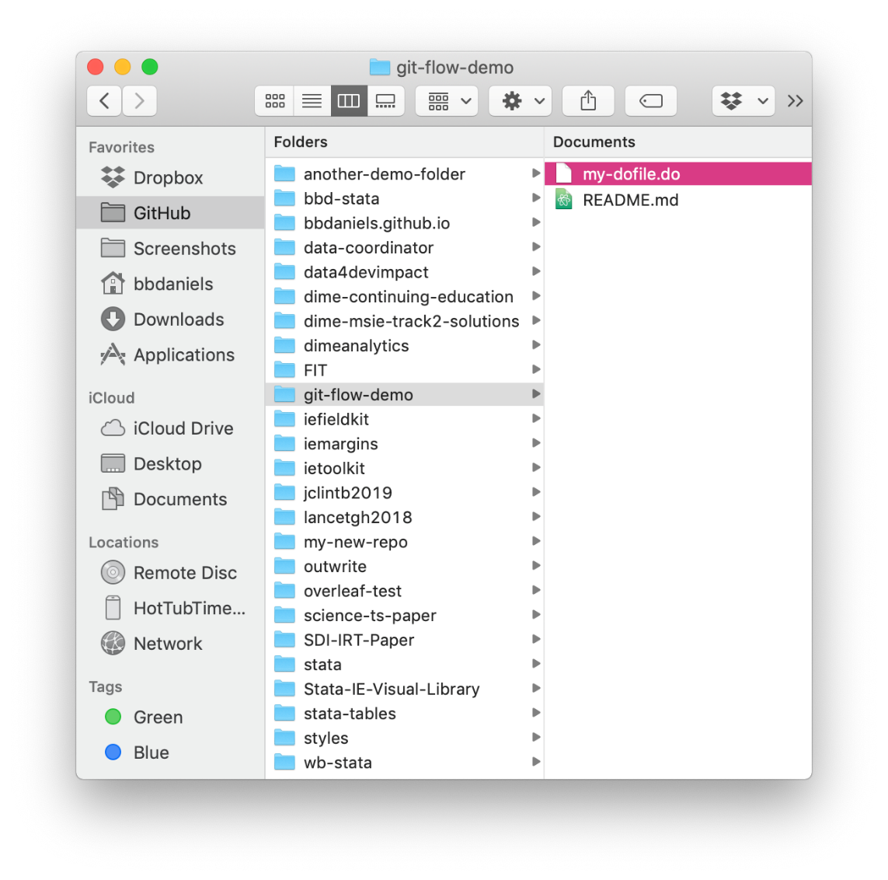
Add some kind of file locally (xx-file initials)

Slide 32
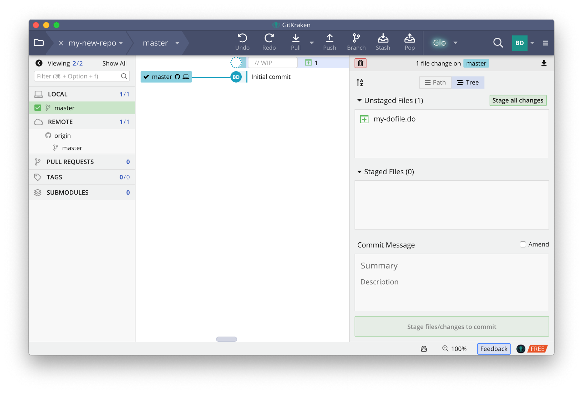
Git notes changes as “work in progress”
4
“Stage” your changes to add them to the queue to be committed.
“Name” your changes informatively – a short sentence will do nicely.
“Commit” your changes to add them to the version history.
“Push” your changes to sync the remote (GitHub) repository with your local copy.
1
2
3

Slide 33
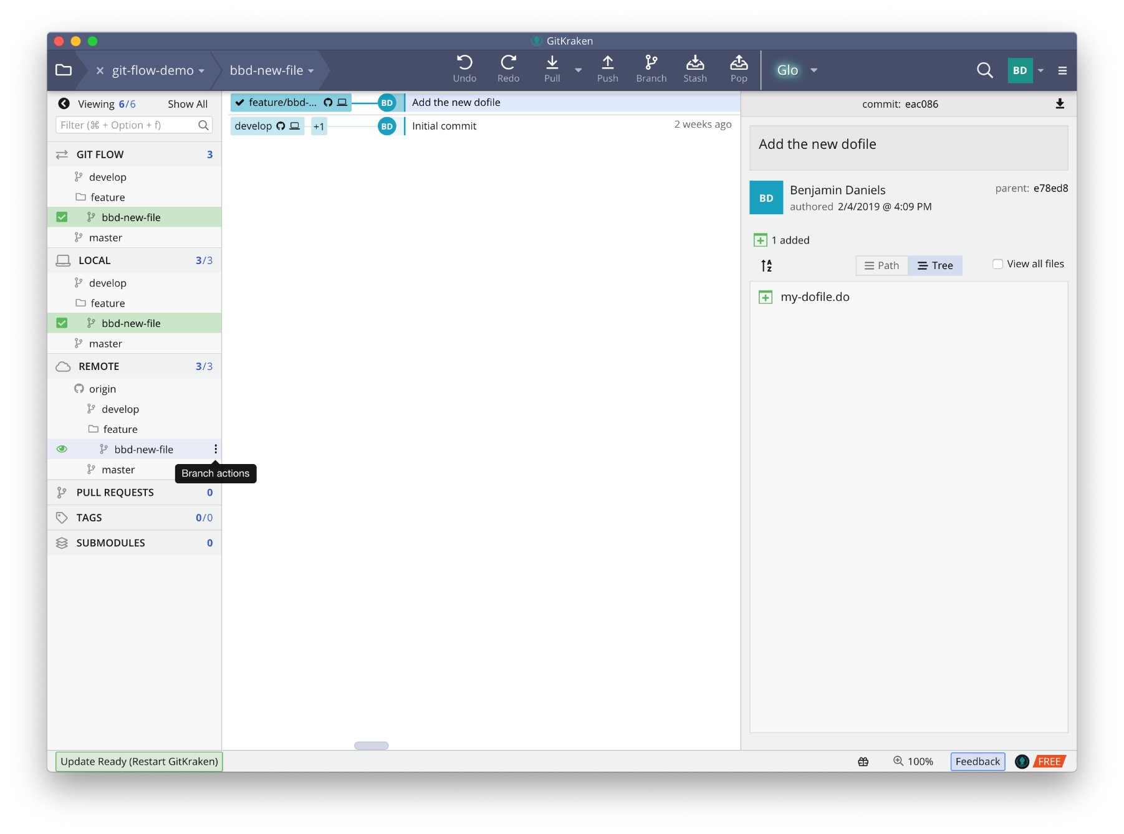
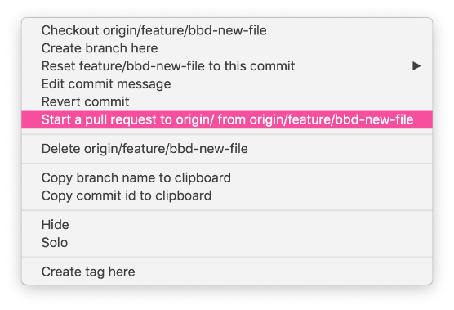
Start a pull request
This can be done by using the context menu from the feature branch under the “remote/origin” header – because this is a GitHub operation, not a Git operation
You can also drag-and-drop the feature branch onto “origin/develop”.

Slide 34
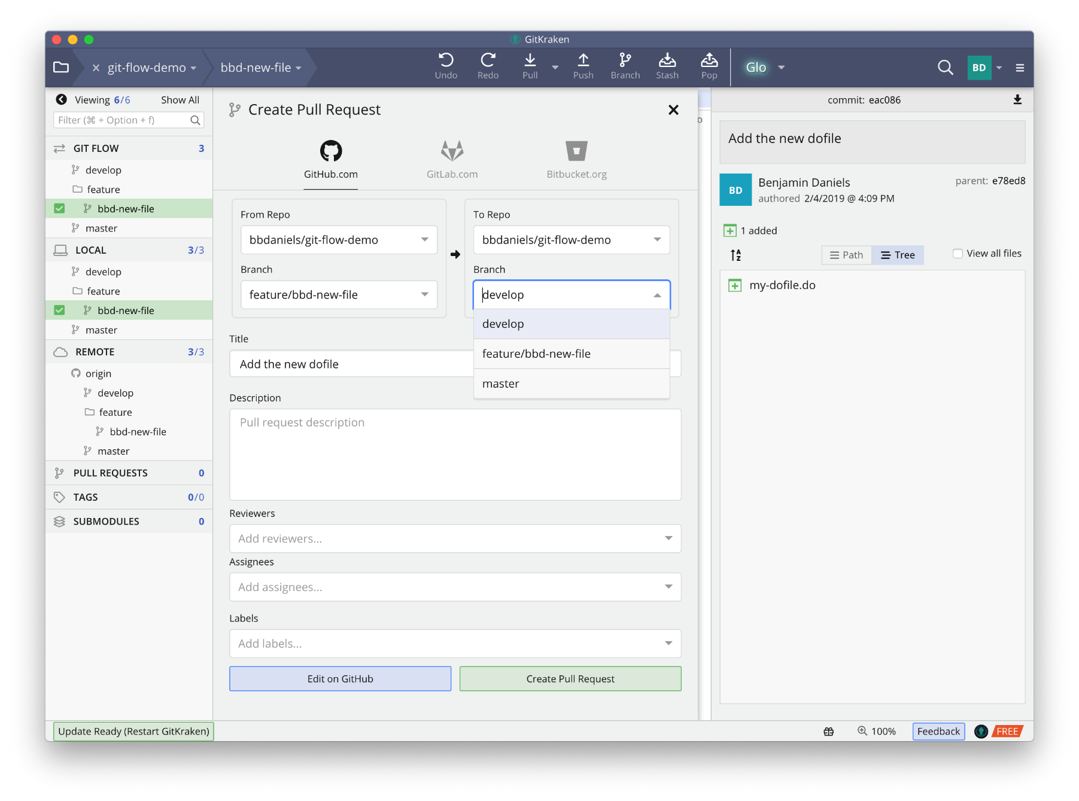
Make sure you target develop
Next, as the administrator, I’ll resolve these on GitHub.
Once the branch is pushed and PRed, you can delete the branch locally.

Slide 35
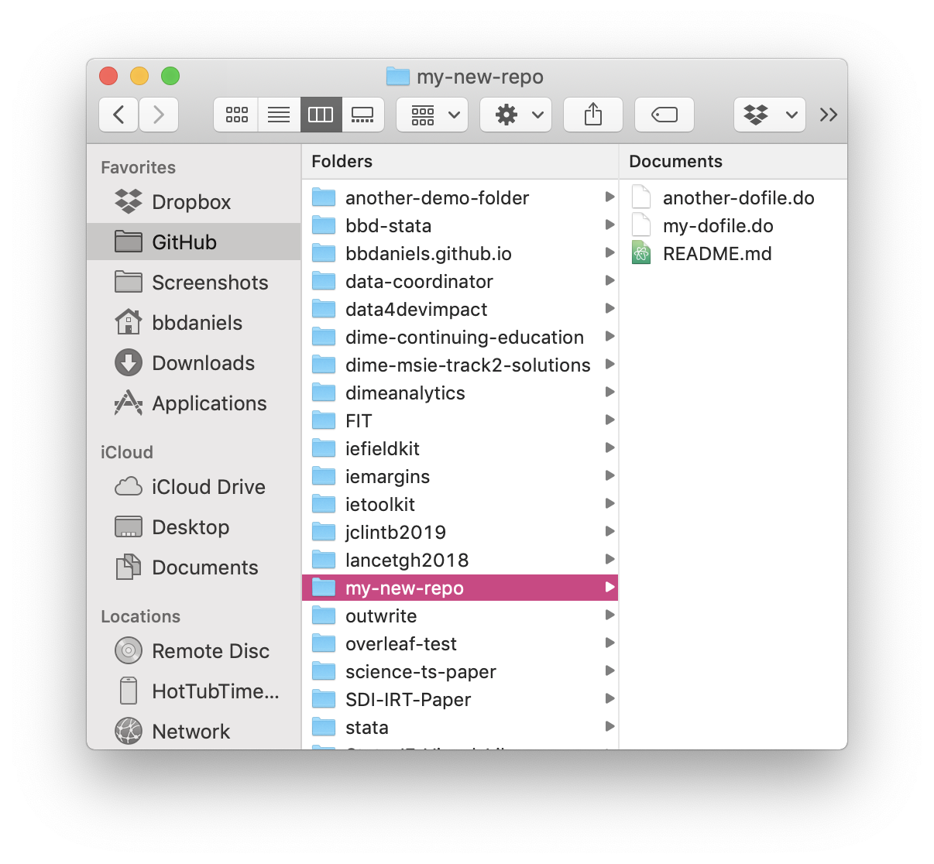
Merging consolidates changes
In the local working directory, you will now see that both files now exist in the same commit, “Merge pull request #1 from bbdaniels/feature/…”, on the develop branch.
Then I will merge these to master so that all those changes are only reflected in a single master commit: a new version!
If people made conflicting changes to the same files, this process also gives you a chance to resolve those, and this and other workflows will be covered in a later session.
That’s all for now!

Slide 36
Thank you!

